Slide 1




PREDICTIVE MODELS FOR BITCOIN PRICE DYNAMICS
20MIA1040 Tanmay Priyadarshi
20MIA1081 Gaurav Sharan
20MIA1122 Chetan Srivastava

Slide 2

PROBLEM STATEMENT
Develop a robust Bitcoin price prediction model using Machine learning techniques , leveraging a comprehensive dataset spanning the years 2014 to 2022. The primary goal is to create an accurate forecasting tool that can navigate the highly volatile cryptocurrency market. This involves collecting and preprocessing historical Bitcoin price data, engineering relevant features, and implementing different machine learning techniques to capture long-term dependencies in the time series. The model's performance will be evaluated using metrics like Mean Absolute Error (MAE) and Mean Squared Error (MSE). Visualization of predictions against actual prices will provide insights into the model's strengths and weaknesses.

Slide 3

ABSTRACT
This study explores the challenging world of Bitcoin, aiming to create a reliable way to predict its price changes. It's divided into two main parts. First, we thoroughly examine daily patterns in the Bitcoin market for eight years, focusing on what mainly affects its price. We use a lot of data covering Bitcoin's prices and how its payment network is used. In the second part, we use this data to make a model that predicts daily Bitcoin price trends accurately. This work is important for better understanding Bitcoin's market behavior and helps investors and researchers deal with the unpredictable nature of cryptocurrency prices.

Slide 4

INTRODUCTION
Bitcoin, a leading cryptocurrency, has garnered immense interest due to its significant price fluctuations and unique market dynamics. This research paper aims to shed light on the intricate patterns governing Bitcoin's value. The first section of our study involves a detailed examination of daily trends in the Bitcoin market over an eight-year period. This phase focuses on identifying key factors that influence Bitcoin's pricing, leveraging extensive data that includes both price variations and payment network activities. The subsequent section of the study is dedicated to developing a predictive model using this comprehensive dataset. The model's primary goal is to accurately predict the direction of Bitcoin's daily price movements. By achieving this, the research provides deeper insights into the behavior of Bitcoin's market and offers a crucial tool for investors and researchers. This tool is particularly valuable for navigating the unpredictable and often volatile landscape of cryptocurrency prices, aiding in strategic decision-making and market analysis.

Slide 5
DATASET DESCRIPTION
The dataset is historical data for Bitcoin prices from 2014 till date, given the columns such as Date, Open, High, Low, Close, Adjusted Close, and Volume. The description of each column in detail is as follows:
Date: This column represents the date of the trading day.
Open: The price at which the first trade of the day occurred.
High: The highest price of Bitcoin reached during the trading day.
Low: The lowest price of Bitcoin reached during the trading day.
Close: The price at which the last trade of the day occurred.
Adj Close: The adjusted closing price, which reflects any corporate actions like dividends, stock splits, or rights offerings.
Volume: The total number of Bitcoin units traded during the day.
The dataset is taken from :https://finance.yahoo.com/quote/BTC-USD/history

Slide 6
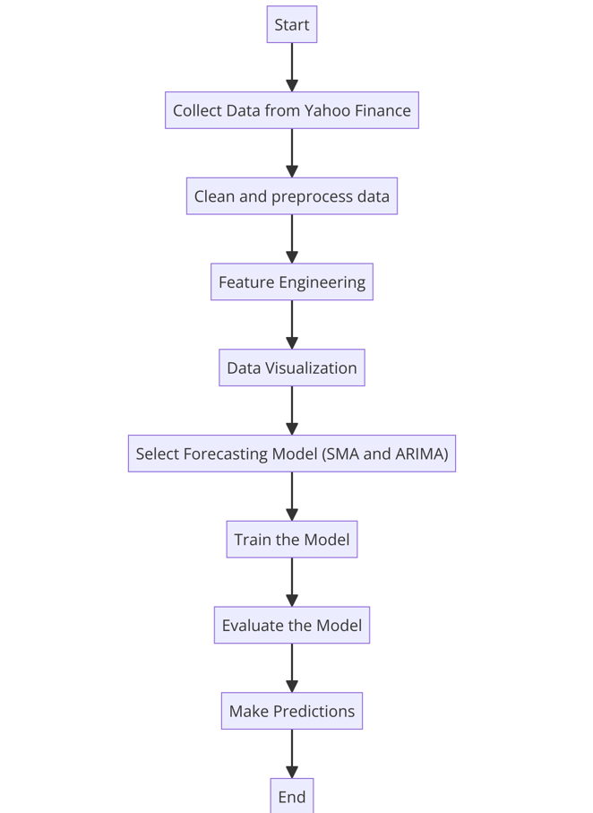
WORK FLOW

Slide 7
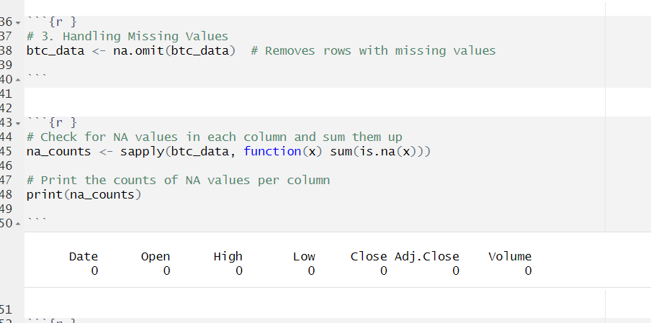
Data Pre Processing
Checking for the null values

Slide 8
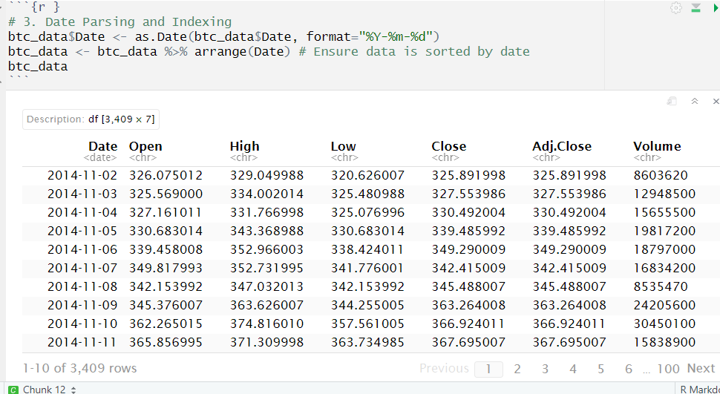
Data Parsing and Indexing

Slide 9
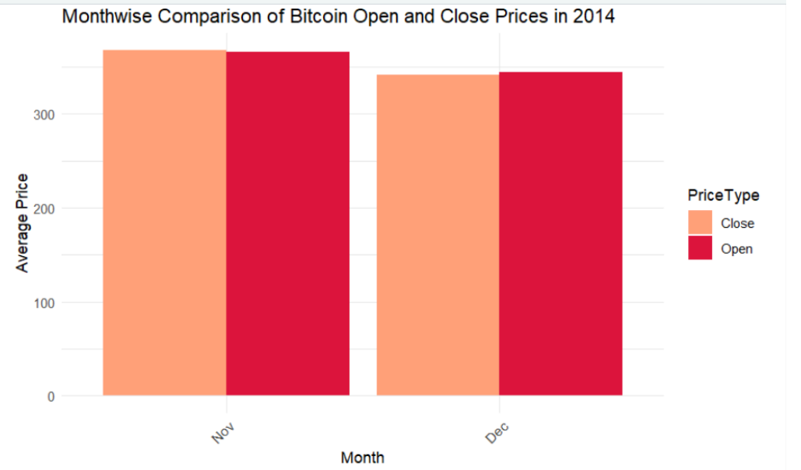
Data Visualization
IN BOTH MONTHS, THE AVERAGE OPENING PRICE, INDICATED BY THE RED BAR, IS HIGHER THAN THE AVERAGE CLOSING PRICE, REPRESENTED BY THE LIGHTER COLORED BAR.

Slide 10
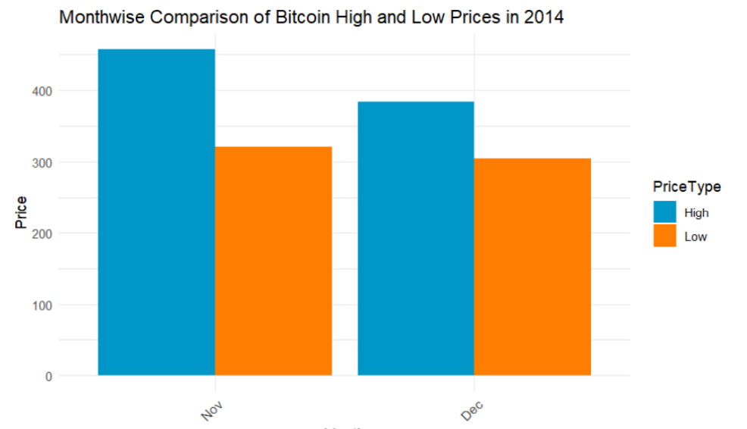
OVERALL, THE CHART REFLECTS THE FLUCTUATIONS IN BITCOIN PRICES WITHIN THESE TWO MONTHS, WITH BOTH MONTHS SHOWING A CONSIDERABLE GAP BETWEEN THE HIGHEST AND LOWEST TRADING PRICES.

Slide 11
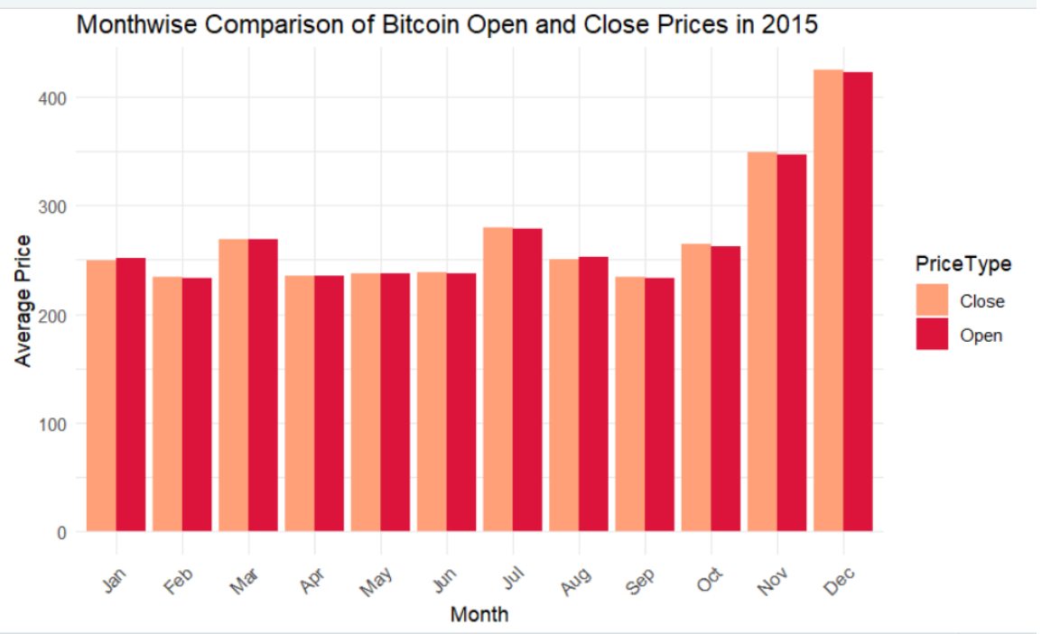
THERE IS A NOTABLE INCREASE IN BOTH THE OPENING AND CLOSING PRICES TOWARDS THE END OF THE YEAR, PARTICULARLY IN NOVEMBER AND DECEMBER. THIS TREND COULD INDICATE A BULLISH MARKET SENTIMENT OR INCREASED DEMAND FOR BITCOIN IN THE FINAL MONTHS OF 2015.

Slide 12
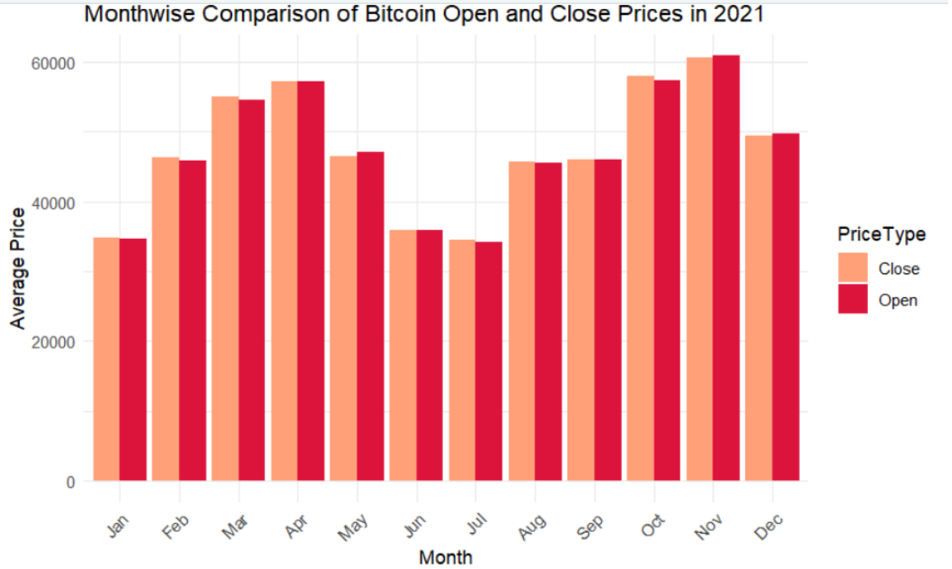
IN THIS GRAPH, BOTH OPENING AND CLOSING PRICES SHOW SIGNIFICANT VOLATILITY THROUGHOUT THE YEAR. SOME MONTHS DISPLAY A HIGHER CLOSING PRICE COMPARED TO THE OPENING PRICE, SUGGESTING A POSITIVE GROWTH WITHIN THAT MONTH.

Slide 13
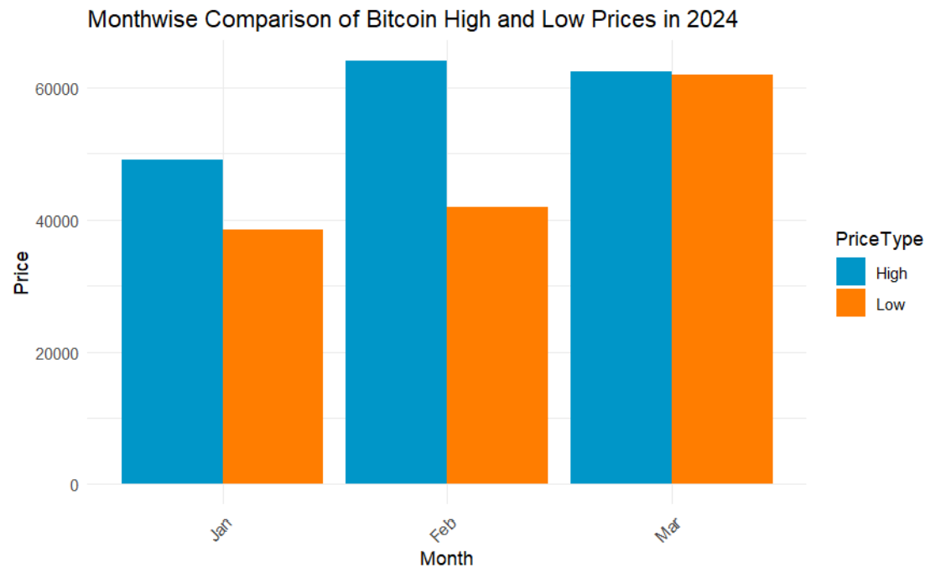
IN JANUARY, BITCOIN'S PRICE RANGE BETWEEN HIGH AND LOW IS NARROWER COMPARED TO FEBRUARY AND MARCH, SUGGESTING LESS VOLATILITY AT THE START OF THE YEAR. FEBRUARY SHOWS THE GREATEST DISPARITY BETWEEN THE HIGH AND LOW PRICES, INDICATING A PERIOD OF HIGHER VOLATILITY.

Slide 14
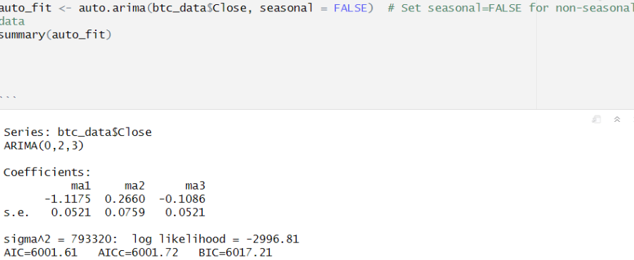
Prediction Using ARIMA MODEL
Model Training

Slide 15
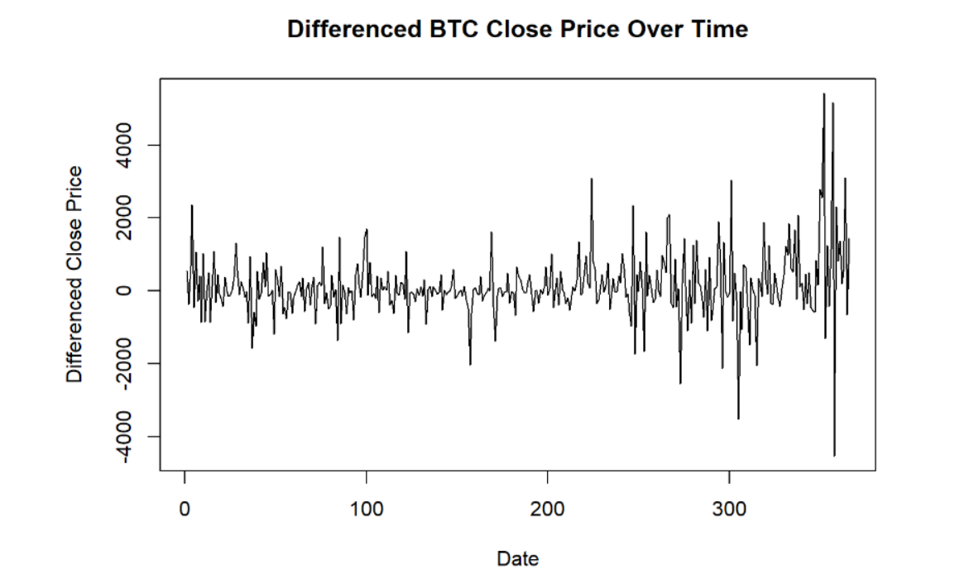
Differenced BTC Close Price over Time
THE GRAPH SHOWS THE DIFFERENCED CLOSING PRICES OF BITCOIN (BTC) OVER TIME, INDICATING DAY-TO-DAY PRICE CHANGES. POSITIVE VALUES REFLECT PRICE INCREASES, WHILE NEGATIVE VALUES INDICATE DROPS, ILLUSTRATING BITCOIN'S VOLATILITY. THIS VISUALIZATION IS USED FOR PREPARING DATA FOR PREDICTIVE ANALYSIS.

Slide 16
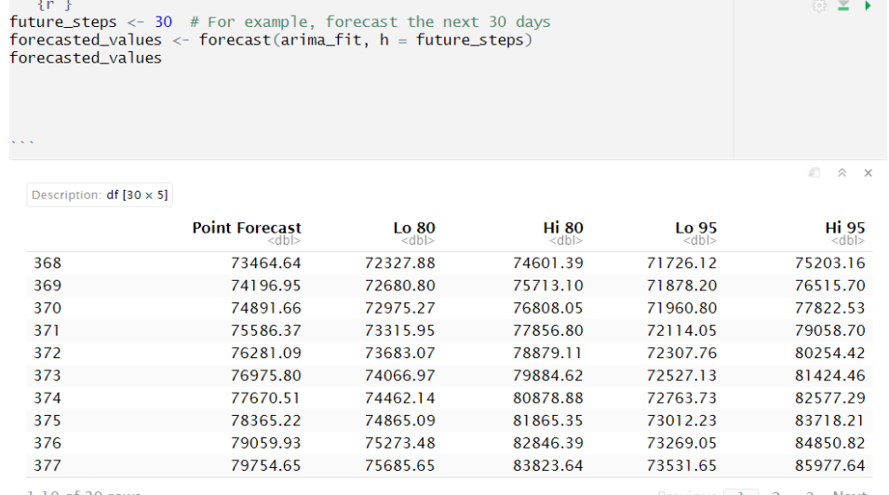
Forecasted values
Point Forecast: The model predicts no change from the last observed value, indicating a flat forecast line typical of an ARIMA(0,1,0) model.
80% Prediction Interval: The Lo 80 and Hi 80 bounds show the range within which there's an 80% chance the true future value will fall.
95% Prediction Interval: The Lo 95 and Hi 95 bounds define a wider range with a 95% probability of containing the true future value.
Certainty Levels: The 95% interval is wider than the 80% interval, reflecting increased confidence that the future value will lie within it.
Forecast Certainty: Narrower intervals indicate higher certainty in predictions, with wider intervals showing less certainty.

Slide 17
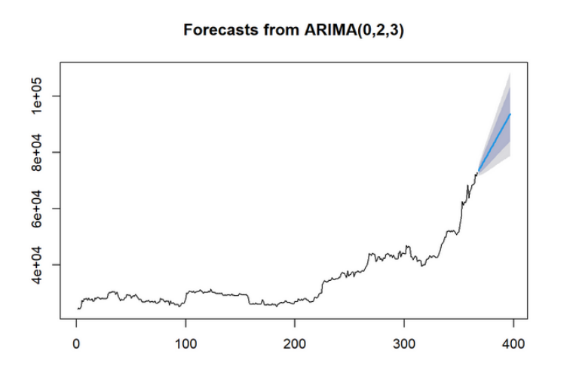
ARIMA FORECASTING
The ARIMA model forecasts a sustained upward trajectory in Bitcoin prices, implying a bullish trend in the cryptocurrency market. This projection is consistent with observed market behavior and investor sentiment, which have favored Bitcoin as a prominent digital asset with potential for long-term appreciation. Despite the optimistic outlook, it's imperative to acknowledge the inherent volatility and unpredictability associated with cryptocurrency markets, as reflected in the widening confidence intervals of our forecasts.

Slide 18
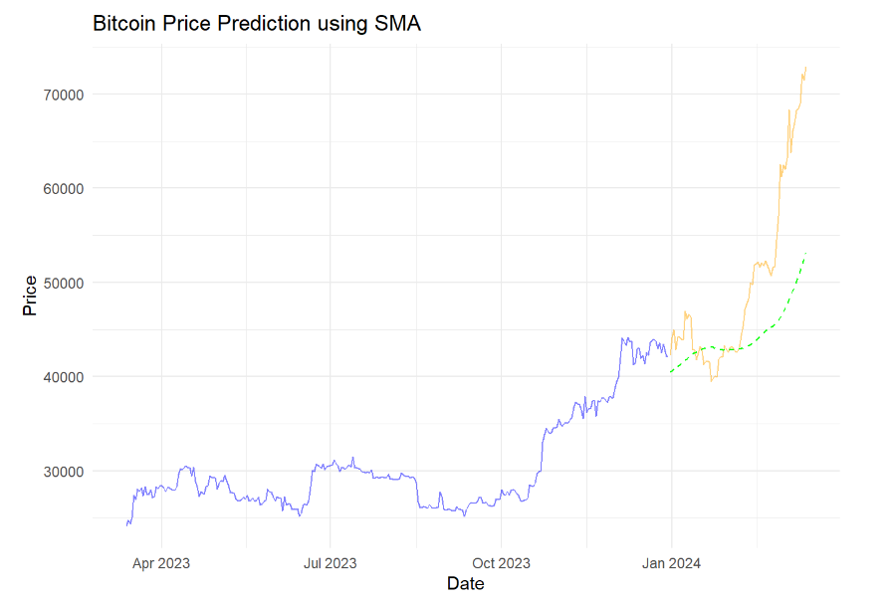
SIMPLE MOVING AVERAGE

Slide 19
Blue line: This is most likely the actual historical price of Bitcoin. It is showing the real price data up until the last recorded point.
Orange line: This likely represents the predicted price of Bitcoin according to the SMA model. The forecast extends beyond the historical data, into the future.
Green dashed line: This line often represents a confidence interval or prediction interval. In forecasting, this is used to indicate the uncertainty in the prediction, showing where the actual future points are likely to fall. Given the context, it’s probably showing a more optimistic prediction or the upper bound of the price forecast.

Slide 20
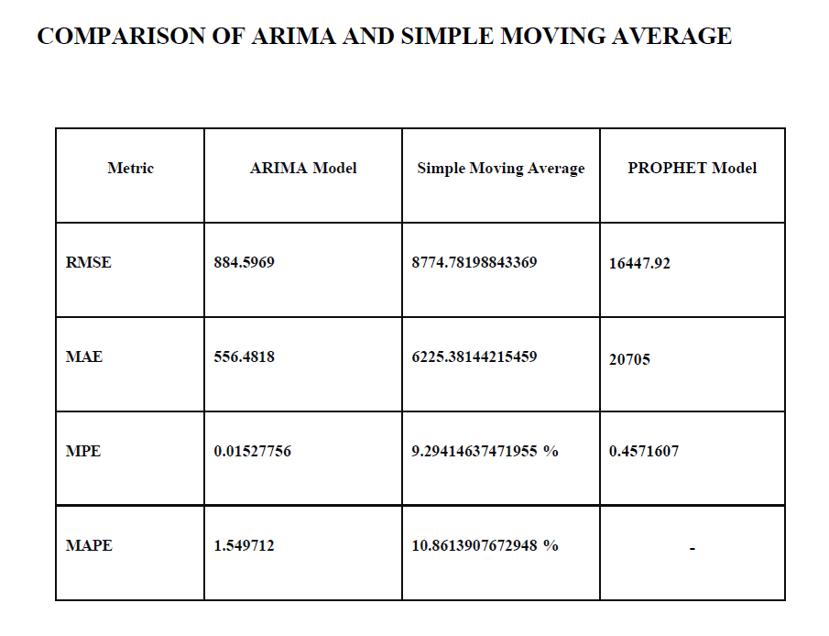
MODEL COMPARISON

Slide 21
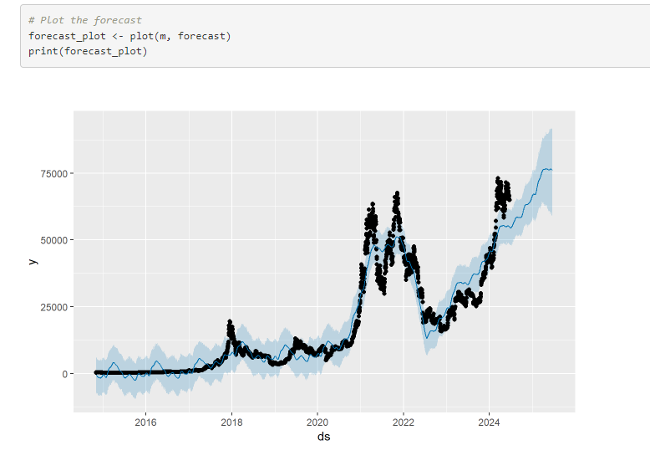
PROPHET MODEL

Slide 22
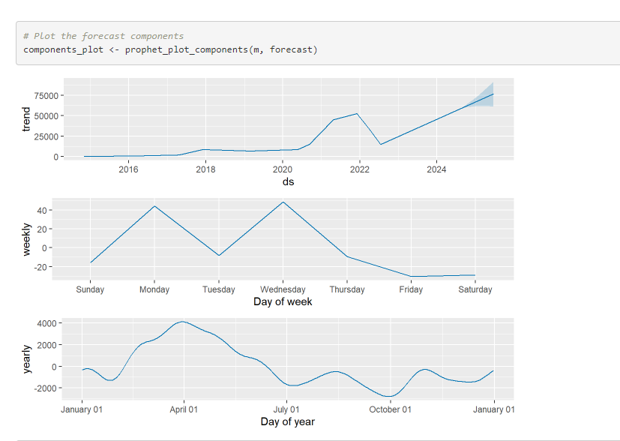
Trend
Weekly
Yearly

Slide 23
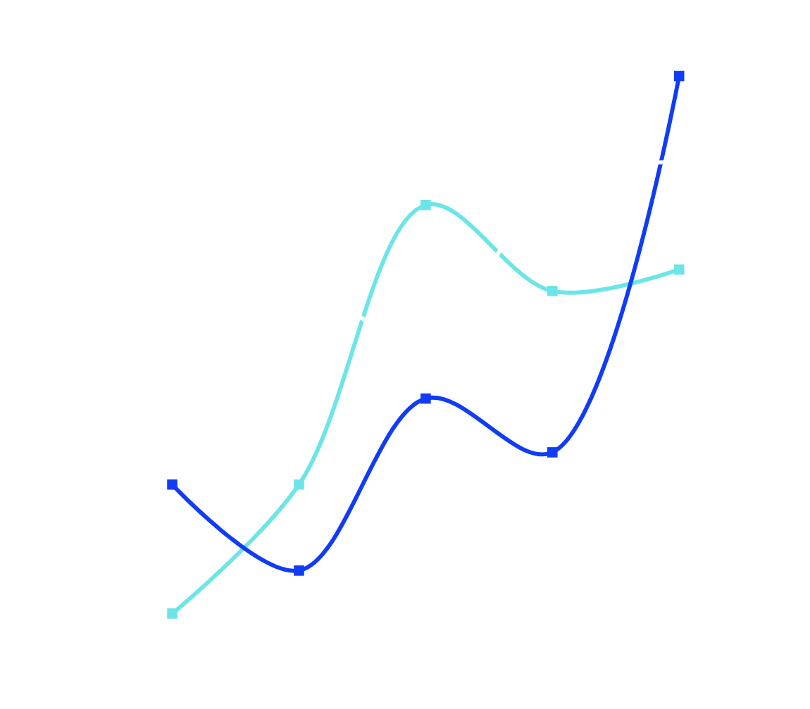
THANK
YOU

